Slide 1


Slide 2

30 Days Python Master Class
Day1 : Python
Time: 6.00 PM IST
Free Registration

Slide 3
Python Master Class
Handbook

Slide 4
NANDHINI.S
Exp: 5 Yrs
Expert in
Python Developer on Machine Learning
Deep learning with computer vision
Matlab – Image Processing
Autonomous Car design using ROS with LIDAR
Language – Python , Java , HTML ,CSS.
Tools – ANACONDA NAVIGATOR, JUPYTER NOTEBOOK,
GOOGLE COLAB.
Graduation : BE – ECE | 2011

Slide 5
Pantech?
Educational Equipment Manufacturer
IoT, AI, Robotics,Autonomous Robot
Microprocessor/Microcontroller
DSP,VLSI, Embedded System
Power Electronics & Drives, Fuel Cell Trainer Kit
Renewable Energy Lab, Electric Vehicle Lab
Technical Training
DIY Project

Slide 6

What is Master Class ?
👍 This is the 30 Days Industrial Learning Activity.
👍 Its Online YouTube Live Class
👍 If you Invest 45 minutes daily, U will become Master in Data Science
👍 You will get FREE E-Certificate
Webinar Participation Certificate
“Learning is the beginning of wealth.
Searching & Learning is where the miracle process all begins.” …………….Jim Rohn

Slide 7
Our Vision
Help 10 Million Students to Learn the Technology in Easy Way

Slide 8

Associate Partner for this Master Class
https://apssdc.in/home/

Slide 9
What U will Learn from 30 Days Data Science & Analytics Master Class

Slide 10





Python Learning Plan
01
02
03
04
05
Library
Python
Analytics
Analytics
Industry Project
Introduction To Python and Python Data Structures
Pandas
Numpy
MatplotLib
Cborn, SKLearn Lib
Collab
Distribution
Visualization
Aggregation
Statistics
Distribution Function
Project Building

Slide 11
Day wise Learning Plan
Day -1 : Introduction to Python
Day -2: Python – Tools|Syntaxes & Data Structures
Day -3: Python – Dictionaries,Date and Time
Day -4: Python – MySql
Day -5: Pandas library – Introduction
Day -6: Pandas library – Data Structures
Day -7: Numpy library – Introduction
Day -8: Numpy library – Array Manipulations, Mathematical Functions
Day -9: Matplotlib , Histogram Using Matplotlib | I/O With Numpy
Day -10: Matplotlib Library - Introduction , Pyplot API | Types Of Plots
Day -11: Seaborn Library
Day -12: SKLearn Library
Day -13: Python – Date and Time , Data Wrangling.
Day -14: Python – Data Cleansing
Day -15: Python – Word Tokenization , Stemming and Lammetization.

Slide 12
Day wise Learning Plan
Day -16: Python – Data Visualization
Day -17: Python – Statistical Analysis
Day -18: Python – Types Of Distribution
Day -19: Python – Correlation ,Chi-Square Test , Linear Regression
Day -20: Keras library – Introduction.
Day -21: Stock Price Prediction With Machine Learning LSTM RNN
Day -22: People’s behaviour in chat message using NLP NLP
Day -23: Gaming In Python
Day -24: Chatbot creation in Python NLP
Day -25: Electricity Price Prediction Using ML Random Forest Regressor
Day -26: Diamond Price Prediction Using Python Linear Regression
Day -27: Book Recommendation System KNN
Day -28: Image Classification Using CNN CNN
Day -29: Titanic Survival Analysis Using ML Logistic Regression
Day -30: Blockchain in Python

Slide 13
List of Projects for Demo in YouTube Live
Stock Price Prediction With Machine Learning
People’s behaviour in chat message using NLP
Gaming In Python
Chatbot creation in Python
Electricity Price Prediction Using ML
Diamond Price Prediction Using Python
Book Recommendation System
Image Classification Using CNN
Titanic Survival Analysis Using ML
Blockchain in Python
All Projects in Jupyter Notebook

Slide 14
What you will get from this Free 30 Days Master Class?
You can attend YouTube Live Class
Free E-Certificate ( WEBINAR PARTICIPATION CERTIFICATE)

Slide 15
How to mark your Attendance in YouTube Live Class?
Ans : During the Live Class, organizer will post Google Form link in Live Chat. The Participants should submit the from on daily basis. Minimum 25 Days Attendance is Required to get Free Master Class Participation Certificate.
Note : The Link will be available during the Live. From the LIVE Class date, the live video will get removed from the YouTube in 3 days.

Slide 16
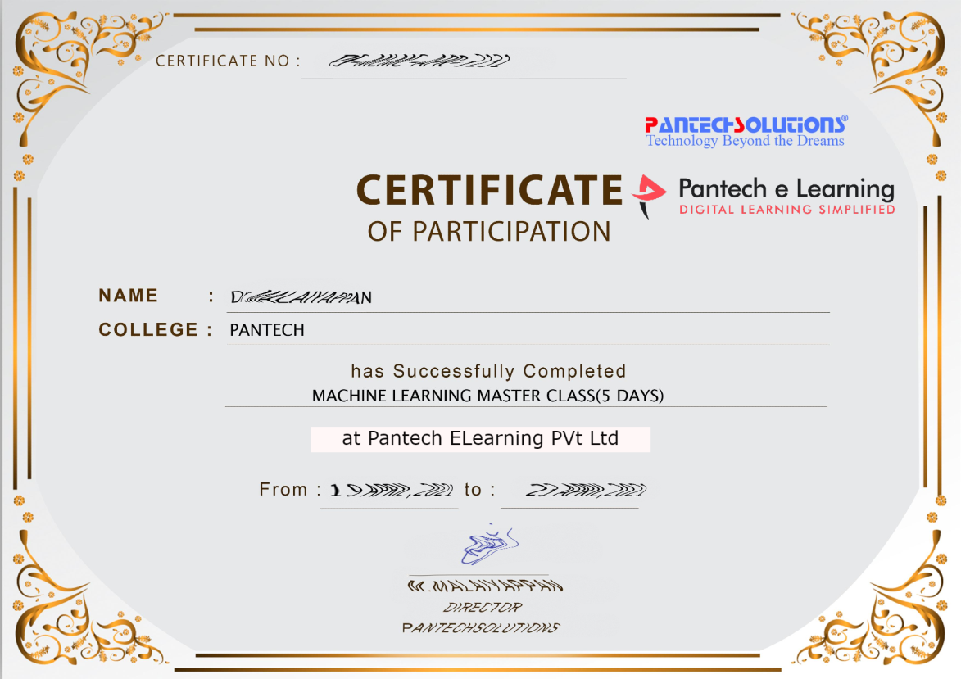

Sample Webinar Participation Certificate?

Slide 17
https://www.pantechelearning.com/data-science-master-class/
On Demand
You can get chance to apply 1 Month Internship on Data Science & Analytics Master Class

Slide 18
What is Internship????
Learn
Practice
Verify
Get Certified
Grow

Slide 19
Free Master Class DSA | 1 Month Internship on DSA
Master Class Participation Certificate | Internship Completion Certificate
Minimum 25 Class should attend YouTube Live | Recorded Class Link will be provided. – LMS Portal Access
YouTube Live Mandatory | Your Choice. You can attend Live or else You can watch Recorded Class in LMS Portal
All Projects Demo class in YouTube Live | Step by Step Video Explanation Content in LMS Portal
Access : 3 Days | VIP WhatsApp Group Support
 | You Can Download All PPTs
 | 4 Nos of Hackathon Class in Zoom Live. The Recording also will be provided
 | You Can Download All Project Files
 | Mentor will guide you to finish 10 Projects
 | Access : 60 Days

Slide 20
Pantech will make you to Create 10 Projects in Data Science & Analytics in 30 Days
Objective of this 30 Days Master Class

Slide 21
1 Month Internship in Data Science
INTERNSHIP E-Certificate(30Days Internship on Data Science Engineering)
Highly organized Video content
Download All Files
Download PPTs
Assignments
Flexible Time.
Access Period: 60Days from the date of payment

Slide 22
What You Will Get???
Complete Project Files
30 Days Learning Activity
Data Science Core Concepts
10 + Projects
Project PPT
Spatial Data Science For Covid-19 Disease Prediction
Parkinson’s Disease Prediction-XGBoost Classifier
House Price Prediction-Random Forest Regression
Customer Segmentation Using ML-K-Means Clustering
Home Loan Prediction-Decision Tree Classifier
Spam Classification-NLP
Hand Written Digit Recognition Using Python-CNN
Churn Prediction-Deep Learning
Crop Yield Prediction
Ground water level prediction
Video Class Access for 2 Months
Get chance to Enroll 1-Month Internship on demand

Slide 23
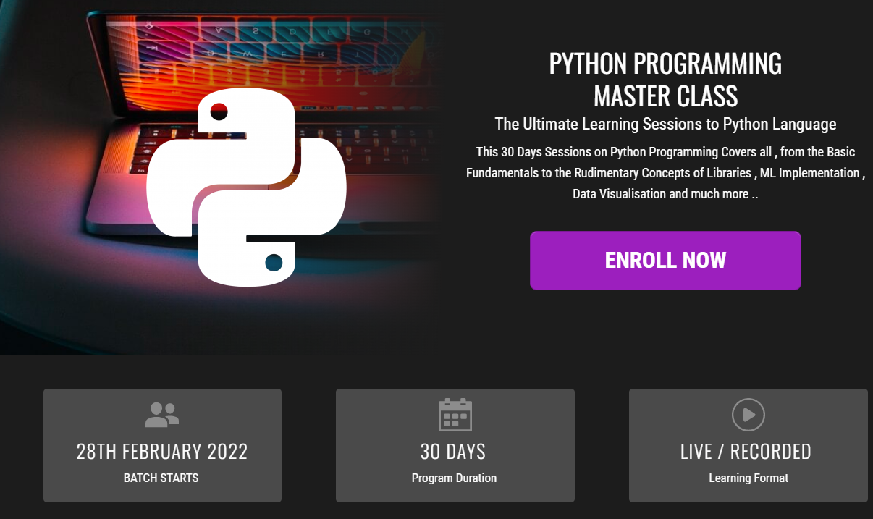
How to join in 1 month Internship
https://www.pantechelearning.com/pymc-internship/
Coupon Code: PYMC

Slide 24
Women’s Christian College
Department Of Computer Applications.
Python Programming For Data Science.
Convenor:
Ms.Sylvia Mary D
(HOD)
(Department Of Computer Applications)

Slide 25
Webinar On Python Programming For Data Science

Slide 26
Overview of Pantech eLearning
Profile
Training
01
04
02
R & D
03
Services
Established on 2004 7 Wings 100+ Team Size
2000 + Workshops 300+ FDP’s 12.5 Lacs + Students
Industrial Design Services Lab Equipment Manufacturer Working on Funded Projects
Workshops, FDP’s Internships, Value Added Courses Online Training Project Guidance

Slide 27
Follow us on:
Instagram--https://instagram.com/pantechelearning?igshid=1fohp030onteu
Telegram--https://t.me/pantechelearning
YouTube--https://youtube.com/c/PantecheLearning.
Podcasts--https://www.instagram.com/tv/COPQIigJZFi/?igshid=4gjhz4dlls1p

Slide 28
Python – Database Connection
A connection can be made to connect to other relational databases using the pandas library.
Other additional libraries can also be used for implementing database connectivity.
SQLAlchemy is a package which provides full sql functionality to be used in python.

Slide 29
SQLAlchemy Installation
Pip install sqlalchemy.

Slide 30
Reading Relational Tables
Sqlite3 is used as a relational database,
It is a very light weight and easy to use database.
SQLAlchemy can connect to a variety of relational sources like MySql , Oracle and Postgresql.
Create a database engine and connect to the database engine to_sql function of the SQLAlchemy library.

Slide 31
Reading Relational Tables
Create a relational table using the to_sql function.
Use the read_sql_query function from the pandas library to execute and capture queries from various SQL queries.

Slide 32
Reading Relational Tables - Examples
from sqlalchemy import create_engine
import pandas as pd
data = pd.read_csv('/path/input.csv')
# Create the db engine
engine = create_engine('sqlite:///:memory:')
# Store the dataframe as a table
data.to_sql('data_table', engine)

Slide 33
Reading Relational Tables - Examples
# Query 1 on the relational table
res1 = pd.read_sql_query('SELECT * FROM data_table', engine)
print('Result 1')
print(res1)
print('')
# Query 2 on the relational table
res2 = pd.read_sql_query('SELECT dept,sum(salary) FROM data_table group by dept', engine)
print('Result 2')
print(res2)

Slide 34
Reading Relational Tables - Output
Result 1
index id name salary start_date dept
0 0 1 Rick 623.30 2012-01-01 IT
1 1 2 Dan 515.20 2013-09-23 Operations
2 2 3 Tusar 611.00 2014-11-15 IT
3 3 4 Ryan 729.00 2014-05-11 HR
4 4 5 Gary 843.25 2015-03-27 Finance
5 5 6 Rasmi 578.00 2013-05-21 IT
6 6 7 Pranab 632.80 2013-07-30 Operations
7 7 8 Guru 722.50 2014-06-17 Finance

Slide 35
Reading Relational Tables - Output
Result 2
dept sum(salary)
0 Finance 1565.75
1 HR 729.00
2 IT 1812.30
3 Operations 1148.00

Slide 36
Inserting Data Into Relational Tables
Data can be inserted into relational tables using sql.execute function available in pandas.
from sqlalchemy import create_engine
from pandas.io import sql
import pandas as pd
data = pd.read_csv('C:/Users/Rasmi/Documents/pydatasci/input.csv') engine = create_engine('sqlite:///:memory:')
# Store the Data in a relational table
data.to_sql('data_table', engine)

Slide 37
Inserting Data Into Relational Tables
# Insert another row
sql.execute('INSERT INTO data_table VALUES(?,?,?,?,?,?)', engine, params=[('id',9,'Ruby',711.20,'2015-03-27','IT')])
# Read from the relational table
res = pd.read_sql_query('SELECT ID,Dept,Name,Salary,start_date FROM data_table', engine)
print(res)

Slide 38
Output
id dept name salary start_date
0 1 IT Rick 623.30 2012-01-01
2 Operations Dan 515.20 2013-09-23
3 IT Tusar 611.00 2014-11-15
4 HR Ryan 729.00 2014-05-11
5 Finance Gary 843.25 2015-03-27
6 IT Rasmi 578.00 2013-05-21
7 Operations Pranab 632.80 2013-07-30
8 Finance Guru 722.50 2014-06-17
9 IT Ruby 711.20 2015-03-27

Slide 39
Deleting Data From Relational Tables
Data can be deleted from related tables using sql.execute function available in pandas.
from sqlalchemy import create_engine
from pandas.io import sql
import pandas as pd
data = pd.read_csv('C:/Users/Rasmi/Documents/pydatasci/input.csv') engine = create_engine('sqlite:///:memory:')

Slide 40
Deleting Data From Relational Tables
data.to_sql('data_table', engine)
sql.execute('Delete from data_table where name = (?) ', engine, params=[('Gary')])
res = pd.read_sql_query('SELECT ID,Dept,Name,Salary,start_date FROM data_table', engine)
print(res)

Slide 41
Output
id dept name salary start_date
0 1 IT Rick 623.3 2012-01-01
2 Operations Dan 515.2 2013-09-23
3 IT Tusar 611.0 2014-11-15
4 HR Ryan 729.0 2014-05-11
6 IT Rasmi 578.0 2013-05-21
7 Operations Pranab 632.8 2013-07-30
8 Finance Guru 722.5 2014-06-17

Slide 42
Python - Pandas
Pandas is a open-source python library.
It provides highly efficient data structures and data analysis tools for python programming language.
Python with pandas is used in a variety of domains like academics,finance,economics,statistics and

Slide 43
PRE-REQUISITES
In order to learn pandas , one should be aware of the computer programming terminologies.
A basic knowledge of other programming languages is essential.
Pandas use most of the functionalities of numpy.
A basic understanding of numpy is necessary to understand pandas.

Slide 44
Pandas
It is a open-source python library used for data manipulation and data analysis.
Python with pandas is used in a variety of domains like statistics , finance and web-analytics.
Using pandas , the following five steps will be accomplished.
Load
Organise
Manipulate
Model
Analyze

Slide 45
Important Features Of Pandas:
Efficient data frame object with customized indexing.
Supports different file formats and used for loading data into in-memory data objects.
Aligns data and handles missing data.
Used for reshaping date sets.
Performs slicing based on labels , indexing and extracts subsets from large datasets.
Can insert columns and delete columns from a dataset.
Data are grouped for aggregation and transformation.

Slide 46
Important Features Of Pandas:
Performance is higher while merging and joining of data.
Provides time-series functionality.

Slide 47
PANDAS – ENVIRONMENT SETUP
Standard python distribution doesn’t have a Pandas module.
Pandas is installed using python package installer pip
Pip install pandas.
Once Anaconda is installed , Pandas will be installed with it.
Anaconda is a open-source python distribution for scipy.
It is available for linux and mac.

Slide 48
Pandas
It deals with the following three data structures.
Series
Data frame
Panel
These data-structures are built on top of numpy array ,thus making them fast and efficient.

Slide 49
Dimension and Description:
Higher dimensional data structure is a container of lower dimensional data structure.
Data-Frame is a container of series and panel is a container of data frame.
Series – It is a one-dimensional collection of similar elements .Series is nothing but a collection of integers.
Points to Consider:
Collection of similar elements.
Size cannot be changed(i.e, it is immutable).
Values of the data can be changed(i.e , it is mutable).

Slide 50
Data Frame:
It is a heterogeneous collection of data elements and the size of the table can be changed.
Data Frame is used in a variety of fields and it is a most useful data structure.
It is a 2D labelled size-mutable tabular data structure.

Slide 51
Panel:
It is nothing but a 3D labelled , size mutable array.
It is difficult to build and handle two or more dimensional arrays .
More burden is placed on the user to consider the orientation of the data when writing functions.
Using Pandas data structure, the mental effort of the user is reduced.
With tabular dataframe , it is useful to think of the index(rows) and the columns rather than axis 0 and axis 1.
All pandas data structure are value mutable(values can be changed).
Except series, all are size mutable.
Series is size immutable.
Data frame is widely used and one of the most important data structure.
Panel is less frequently used data structure.

Slide 52
Panel:
Panel is nothing but a three-dimensional data structure with heterogeneous collection of data.
Panel can’t be represented in a graphical format.
Panel can be illustrated as a container of dataframe.
Important Points:
Heterogeneous data
Size mutable
Data mutable

Slide 53
Series:
It is a one-dimensional data structure with homogeneous collection of elements.
For example , it contains a collection of integers like 10,20,30,40,50.
Pandas – Series:
A pandas series can be denoted by the following constructor:
pandas.Series( data, index, dtype, copy)

Slide 54
Series:
The parameters of the constructor are as follows:
Data: It takes various forms like ndarray, lists and constants.
Index: Index values must be unique values.
The hashtable should be of the same length as the data.
Default is np.arange(n) if no index is passed.
Dtype: dtype indicates the datatype.
If no values are passed , then datatypes will be inferred.
Copy: It contains a copy of the data.
Default value is false.

Slide 55
Series:
A series can be created using various inputs like:
Array
Dict
Scalar value or constant.
Creation of Empty Series:
A basic series can be created and it is called an empty series.

Slide 56
Example:
#import the pandas library and aliasing as pd
import pandas as pd
s = pd.Series()
print (s)
Output:
Series([], dtype: float64)

Slide 57
Create a series from ndarray:
If data passed is an ndarray , then index passed must be of the same length.
If no index is passed, then by default index will be of range(n) where n is the array length.
[0,1,2,3…. range(len(array))-1].

Slide 58
Example 1:
#import the pandas library and aliasing as pd
import pandas as pd
import numpy as np
data = np.array(['a','b','c','d'])
s = pd.Series(data)
print (s)

Slide 59
OUTPUT:
0 a
b
c
d
dtype: object
No index values are passed.
By default , it assigned the indices ranging from 0 to len(data)-1, i.e from 0 to 3.

Slide 60
EXAMPLE 2:
#import the pandas library and aliasing as pd
import pandas as pd
import numpy as np
data = np.array([‘b',‘c',‘d',‘a'])
s = pd.Series(data,index=[10,11,12,13])
print (s)

Slide 61
Output:
10 b
11 c
12 d
13 a
dtype: object

Slide 62
Create a series from Dict:
A dictionary can be passed as an input.
If no index is specified , then dictionary keys are taken in a sorted order to create an index.
If index is passed , then values in the data corresponding to the labels in the index will be pulled out.

Slide 63
EXAMPLE 1:
#import the pandas library and aliasing as pd
import pandas as pd
import numpy as np
data = {'a' : 0., 'b' : 1., 'c' : 2.}
s = pd.Series(data)
Print(s)

Slide 64
OUTPUT:
a 0.0
b 1.0
c 2.0
dtype: float64
Dictionary keys are used to construct the index.

Slide 65
EXAMPLE 2:
#import the pandas library and aliasing as pd
import pandas as pd
import numpy as np
data = {'a' : 0., 'b' : 1., 'c' : 2.}
s = pd.Series(data,index=['b','c','d','a'])
print (s)

Slide 66
Output:
B 1.0
c 2.0
d NaN
a 0.0
dtype: float64
We can see that the index order is persisted and the missing element is filled with NaN(not a number)

Slide 67
Create a Series From a Scalar:
If the data is a scalar value , then an index must be provided.
Value will be repeated to match the length of the index.

Slide 68
Example:
#import the pandas library and aliasing as pd
import pandas as pd
import numpy as np
s = pd.Series(5, index=[0, 1, 2, 3])
print (s)

Slide 69
Output:
0 5
1 5
2 5
3 5
dtype: int64

Slide 70
Accessing data from series with position:
Data in a series can be accessed similar to that in an ndimensional array.
Example:
Retrieve the first element.
Counting starts from zero in the array .
It means that the first element is stored at the 0th position and so on.
import pandas as pd
s = pd.Series([1,2,3,4,5],index = ['a','b','c','d','e']) #retrieve the first element
print s[0]

Slide 71
Output:
1

Slide 72
Example 3:
Retrieve the first three elements in the series
If a: is inserted in front of it, all items from that index onwards will be extracted.
If two parameters (with : between them is used),items between these two index positions will be extracted.
End index will be excluded.

Slide 73
Example 3:
import pandas as pd
s = pd.Series([1,2,3,4,5],index = ['a','b','c','d','e']) #retrieve the first three element
print (s[:3])
Output:
a 1
b 2
c 3
dtype: int64

Slide 74
Example 4:
Retrieve the last three elements:
import pandas as pd
s = pd.Series([1,2,3,4,5],index = ['a','b','c','d','e']) #retrieve the last three element
print (s[-3:])

Slide 75
Output:
c 3
d 4
e 5
dtype: int64

Slide 76
Retrieve the Data using Label(Index)
A series is like a fixed-size dict .
In a dictionary , we can get and set values by index label.
Example: Retrieve a single element using index label value.
import pandas as pd
s = pd.Series([1,2,3,4,5],index = ['a','b','c','d','e']) #retrieve a single element
print (s['a'])
Output:
1

Slide 77
Example:
Retrieve multiple elements using a list of label index values.
import pandas as pd
s = pd.Series([1,2,3,4,5],index = ['a','b','c','d','e']) #retrieve multiple elements
print (s[['a','c','d']])
Output:
a 1
c 3
d 4
dtype: int64

Slide 78
Example 5:
If a label is not contained , then an exception is raised.
import pandas as pd
s = pd.Series([1,2,3,4,5],index = ['a','b','c','d','e']) #retrieve multiple elements
print (s['f'])
Output:
KeyError: 'f'

Slide 79
Data Frame:
It is two dimensional array with different data elements(i.e , it is a heterogeneous collection of data elements).
Data is stored in a tabular format in the form of rows and columns.
Foreg , consider the following dataframe.
Name Dept Semester Percentage
Sam ECE I 78
Geetha CSE II 85
Kala ECE III 75
Mala CSE IV 70

Slide 80
Features Of DataFrame:
Columns are of different types.
The size of the dataframe can be changed(i.e size – mutable)
Labeled axes(rows and columns)
Various arithmetic operations can be performed on rows and columns.
Pandas.DataFrame:
A pandas dataframe can be created using the following constructor.
pandas.DataFrame( data, index, columns, dtype, copy)

Slide 81
Parameters:
Data: data takes various forms like ndarray , series,map,list,dict,const and also DataFrame.
Index: For row labels , the index to be used for the resulting frame is optional.
Default is np.arange(n) if no index is passed.
Columns: For column labels , the default value is np.arange(n).
This is only true if no index is passed.
Dtype: Specifies the datatype of each column.
Copy: This command is used for copying the data if the default is false.

Slide 82
DataFrame Creation:
A pandas dataframe can be created by using various inputs like:
Lists
Dict
Series
Numpy adarrays
Another DataFrame

Slide 83
Data Frame Description:
The table contains the students performance department –wise and their percentage marks in each semseter. Data is represented in the form of rows and columns. Each column denotes an attribute and each row denotes a student/person.

Slide 84
Data Type Of Columns
Name – String
Dept – String
Semester – String
Percentage – Integer
Heterogeneous collection of data(Collection of different data elements)
Size can be changed(Size mutable)
Data can be changed(Data mutable)

Slide 85
Empty DataFrame Creation:
A Basic DataFrame can be created and it is called an empty DataFrame.
#import the pandas library and aliasing as pd
import pandas as pd
df = pd.DataFrame()
print (df)
Output:
Empty DataFrame
Columns: []
Index: []

Slide 86
Pandas - Example
Pandas data frame consists of 3 principal components namely the data ,rows and columns.
Data frame can be created from a list ,dictionary and from a list of dictionary.
Import pandas as pd;
Lst = [‘sun’, ‘earth’, ‘mars’, ‘venus’, moon’]
Df = pd.DataFrame(lst)
Print(df)

Slide 87
DOUBTS:

Slide 88
Pandas - Example
import pandas as pd
data = [1,2,3,4,5]
df = pd.DataFrame(data)
print (df)

Slide 89
Output:
0 1
1 2
2 3
3 4
4 5

Slide 90
Example
import pandas as pd
data = [['Ros',10],['Popy',12],['Sunny',13]]
df = pd.DataFrame(data,columns=['Name','Age'])
print (df)

Slide 92
Output:
Name Age
0 Ros 10
1 Pop 12
2 Lucy 20

Slide 93
Create a data frame from Dict of n darrays/list
All the ndarrays must be of the same length.
If the index is passed , then the length of the index should be equal to the length of the arrays.
If no index is passed , then by default , index will be of range(n) where n is the array length.

Slide 94
Example:
import pandas as pd
data = {'Name':['Tom', ‘Sam', ‘Ricky', ‘Steve'],'Age':[28,34,29,42]}
df = pd.DataFrame(data)
print df

Slide 95
Output:
Age Name
0 28 Tom
1 34 Sam
2 29 Ricky
3 42 Steve

Slide 96
Indexed Data Frame Using Arrays
Create an indexed data frame using arrays.
import pandas as pd
data = {'Name':['Tom', 'Jack', 'Steve', 'Ricky'],'Age':[28,34,29,42]}
df = pd.DataFrame(data, index=['rank1','rank2','rank3','rank4'])
print df

Slide 97
Output:
Age Name
Rank 1 20 Sam
Rank 2 30 Yolo
Rank 3 40 Kala
Rank 4 50 Rita

Slide 98
Create a Data Frame from list of Dicts:
List of dictionaries can be passed as input to create a data frame.
Example 1:
Create a dictionary by passing a list of dataframes.
import pandas as pd
data = [{'a': 3, 'b': 5},{'a': 5, 'b': 10, 'c': 20}]
df = pd . DataFrame(data)
print df

Slide 99
Output:
a b c
0 3 5 NaN
1 5 10 15

Slide 100
Create a data frame by passing a list of dictionaries and row indices:
import pandas as pd
data = [{'a': 1, 'b': 2},{'a': 5, 'b': 10, 'c': 20}]
df = pd.DataFrame(data, index=['first', 'second'])
print df

Slide 101
Output:
a b c
First 1 2 NaN
Second 5 10 20

Slide 102
Task:
Write a python program to illustrate the use of passing a dictionary to a dataframe.

Slide 103
Example 3:
Create a data frame with a list of dictionaries , row indices and column indices.
import pandas as pd
data = [{'a': 1, 'b': 2},{'a': 5, 'b': 10, 'c': 20}] #With two column indices, values same as dictionary keys
df1 = pd.DataFrame(data, index=['first', 'second'], columns=['a', 'b']) #With two column indices with one index with other name
df2 = pd.DataFrame(data, index=['first', 'second'], columns=['a', 'b1'])
print df1
print df2

Slide 104
Output:
#df1 output a b
first 1 2
second 5 10
#df2 output a b1
first 1 NaN
second 5 NaN

Slide 105
Fill in the missing code:
import pandas as ____
data _____[{'a': 1, 'b': 2},{'a': 5, 'b': 10, 'c': 20}] #With two column indices, values same as dictionary keys
df1 = _____.DataFrame(data, index=['first', 'second'], columns=['a', 'b']) #With two column indices with one index with other name
df2 = ______.DataFrame(data, index=['first', 'second'], columns=['a', 'b1'])
print df1
print df2

Slide 106
Create a data frame from dict of series:
Dictionary of series can be passed to form a data frame.
Resultant index is the union of all the series indexes passed.
import pandas as pd
d = {'one' : pd.Series([1, 2, 3],
index=['a', 'b', 'c']),
'two' : pd.Series([1, 2, 3, 4],
index=['a', 'b', 'c', 'd'])}
df = pd.DataFrame(d)
Print(df)

Slide 107
Output:
one two
A 1.0 1
B 2.0 2
C 3.0 3
C NaN 4

Slide 108
Column Selection:
We can understand this by selecting a column from the database.
Example:
import pandas as pd
d = {'one' : pd.Series([1, 2, 3],
index=['a', 'b', 'c']), 'two' : pd.Series([1, 2, 3, 4], index=['a', 'b', 'c', 'd'])}
df = pd.DataFrame(d)
print df ['one']

Slide 109
DOUBTS:

Slide 110
Output:
a 1.0
b 2.0
c 3.0
d NaN
Name: one, dtype: float64

Slide 111
Column Addition:
We can understand this concept by adding a new column to the dataframe.
import pandas as pd
d = {'one' : pd.Series([1, 2, 3], index=['a', 'b', 'c']), 'two' : pd.Series([1, 2, 3, 4], index=['a', 'b', 'c', 'd'])}
df = pd.DataFrame(d) # Adding a new column to an existing DataFrame object with column label by passing new series
print ("Adding a new column by passing as Series:") df['three']=pd.Series([10,20,30],index=['a','b','c'])
print df print ("Adding a new column using the existing columns in DataFrame:") df['four']=df['one']+df['three']
print df

Slide 112
DOUBTS:

Slide 113
Output:
Adding a new column by passing as Series:
one two three
a 1.0 1 10.0
b 2.0 2 20.0
c 3.0 3 30.0
d NaN 4 NaN

Slide 114
Adding a new column using the existing columns in DataFrame:
one two three four
a 1.0 1 10.0 11.0
b 2.0 2 20.0 22.0
c 3.0 3 30.0 33.0
d NaN 4 NaN NaN

Slide 115
Column Deletion:
Columns can be deleted or popped.

Slide 116
EXAMPLE:
# Using the previous DataFrame, we will delete a column # using del function
import pandas as pd
d = {'one' : pd.Series([1, 2, 3],
index=['a', 'b', 'c']), 'two' : pd.Series([1, 2, 3, 4], index=['a', 'b', 'c', 'd']), 'three' : pd.Series([10,20,30], index=['a','b','c'])}
df = pd.DataFrame(d)
print ("Our dataframe is:")
print df # using del function
print ("Deleting the first column using DEL function:")
del df['one']
print df # using pop function print ("Deleting another column using POP function:")
df.pop('two')
print df

Slide 117
Output:
Our dataframe is: one three two a 1.0 10.0 1 b 2.0 20.0 2 c 3.0 30.0 3 d NaN NaN 4 Deleting the first column using DEL function: three two a 10.0 1 b 20.0 2 c 30.0 3 d NaN 4 Deleting another column using POP function: three a 10.0 b 20.0 c 30.0 d NaN

Slide 118
Row selection , deletion and addition:
Selection by label:
import pandas as pd
d = {'one' : pd.Series([1, 2, 3],
index=['a', 'b', 'c']),
'two' : pd.Series([1, 2, 3, 4],
index=['a', 'b', 'c', 'd'])}
df = pd.DataFrame(d)
print df.loc['b']

Slide 119
Output:
one 2.0 two 2.0 Name: b, dtype: float64

Slide 120
Selection by integer location:
Rows can be selected by passing the integer location to the iloc function.
import pandas as pd d = {'one' : pd.Series([1, 2, 3], index=['a', 'b', 'c']), 'two' : pd.Series([1, 2, 3, 4], index=['a', 'b', 'c', 'd'])} df = pd.DataFrame(d) print df.iloc[2]

Slide 121
Output:
one 3.0 two 3.0 Name: c, dtype: float64

Slide 122
Slice Rows:
import pandas as pd
d = {'one' : pd.Series([1, 2, 3],
index=['a', 'b', 'c']), 'two' : pd.Series([1, 2, 3, 4], index=['a', 'b', 'c', 'd'])}
df = pd.DataFrame(d)
print df[2:4]

Slide 123
one two c 3.0 3 d NaN 4

Slide 124
Addition of Rows:
import pandas as pd
df = pd.DataFrame([[1, 2], [3, 4]], columns = ['a','b']) df2 = pd.DataFrame([[5, 6], [7, 8]], columns = ['a','b']) df = df.append(df2)
print df

Slide 125
Output:
a b 0 1 2 1 3 4 0 5 6 1 7 8

Slide 126
Deletion of Rows:
import pandas as pd df = pd.DataFrame([[1, 2], [3, 4]], columns = ['a','b']) df2 = pd.DataFrame([[5, 6], [7, 8]], columns = ['a','b']) df = df.append(df2) # Drop rows with label 0 df = df.drop(0) print df

Slide 127
Output:
a b 1 3 4 1 7 8

Slide 128
Follow us on:
Instagram--https://instagram.com/pantechelearning?igshid=1fohp030onteu
Telegram--https://t.me/pantechelearning
YouTube--https://youtube.com/c/PantecheLearning.
Podcasts--https://www.instagram.com/tv/COPQIigJZFi/?igshid=4gjhz4dlls1p

Slide 129
After Internship Registration what you have to do?
Login to www.pantechelearning.com
Access the Video on daily basis for next 30 Days. Practice the Concept and submit assignments
Ask your doubts in VIP Group. Group link is avail in your dashboard.
Finish all the videos and download your Certificate from your dashboard

Slide 130

Internship Certificate (Sample)

Slide 131
Happy learning
30 Days Internship on Machine Learning Master Class
Reg Link: https://imjo.in/Rb6xqe
Discount Coupon Code: WELCOMEML
Call / whatsapp : +91 9840974408

Slide 132
THANKS
Further Information:
Senthil Kumar – 98409 74406
Srinivasan – 7010888841
Kumarasamy - 8925533489
www.pantechelearning.com | training@pantechmail.com

